Slide 1
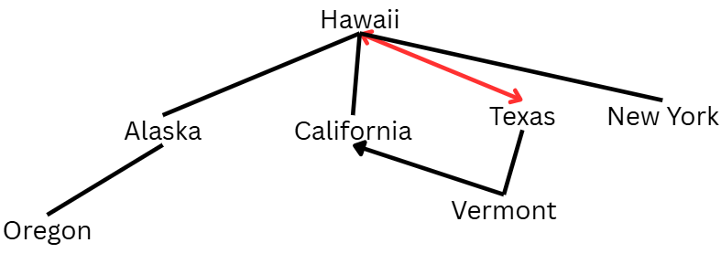
CMSC204
Kartchner
V(StateGraph) = {Oregon, Alaska, Texas, Hawaii, Vermont, NewYork, California}
E(StateGraph) = {(Alaska, Oregon), (Hawaii, Alaska), (Hawaii, Texas), (Texas, Hawaii), (Hawaii, California), (Hawaii, New York), (Texas, Vermont), (Vermont, California), (Vermont, Alaska)}
1. Draw the StateGraph
1. Describe the graph pictured above, using the formal graph notation.
V(StateGraph) = {Oregon, Alaska, Texas, Hawaii, Vermont, New York, California}
E(StateGraph) = {(Alaska, Oregon), (Hawaii, Alaska), (Hawaii, Texas), (Texas, Hawaii), (Hawaii, California), (Hawaii, NewYork), (Texas, Vermont), (Vermont, California), (Vermont, Alaska)}
2. a. Is there a path from Oregon to any other state in the graph?
No. Oregon has no edges outwards. No path from Oregon to any other state.
b. Is there a path from Hawaii to every other state in the graph?
Yes, since it is at the top of the chart.
c. From which state(s) in the graph is there a path to Hawaii?
Only from Texas.

Slide 2
a. Show the adjacency matrix that would describe the edges in the graph. Store the vertices in alphabetical order
 | A | C | H | N | O | T | V
A | 0 | 0 | 0 | 0 | 1 | 0 | 0
C | 0 | 0 | 0 | 0 | 0 | 0 | 0
H | 1 | 1 | 0 | 1 | 0 | 1 | 0
N | 0 | 0 | 0 | 0 | 0 | 0 | 0
O | 0 | 0 | 0 | 0 | 0 | 0 | 0
T | 0 | 0 | 1 | 0 | 0 | 0 | 1
V | 1 | 1 | 0 | 0 | 0 | 0 | 0
3. b. Show the adjacency lists
that would describe the edges in the graph
Alaska: {Oregon}
California: {}
Hawaii: {Alaska, California, New York, Texas}
New York: {}
Oregon: {}
Texas: {Hawaii, Vermont}
Vermont: {Alaska, California}

Slide 3
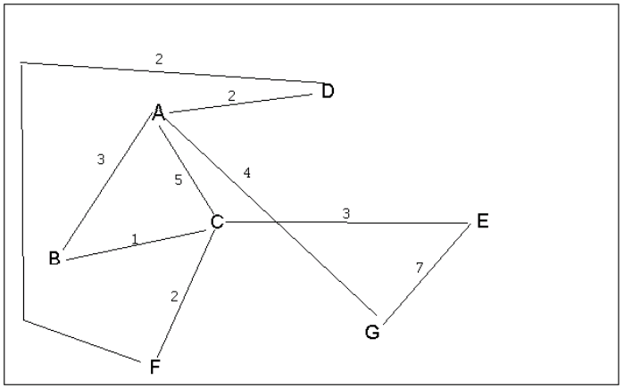
4 a. Which of the following lists the graph nodes in depth first order beginning with E?
A) E, G, F, C, D, B, A
B) G, A, E, C, B, F, D
C) E, G, A, D, F, C, B
D) E, C, F, B, A, D, G
4 b. Which of the following lists the graph nodes in breadth first order beginning at F?
A) F, C, D, A, B, E, G
B) F, D, C, A, B, C, G
C) F, C, D, B, G, A, E
D) a, b, and c are all breadth first traversals

Slide 4
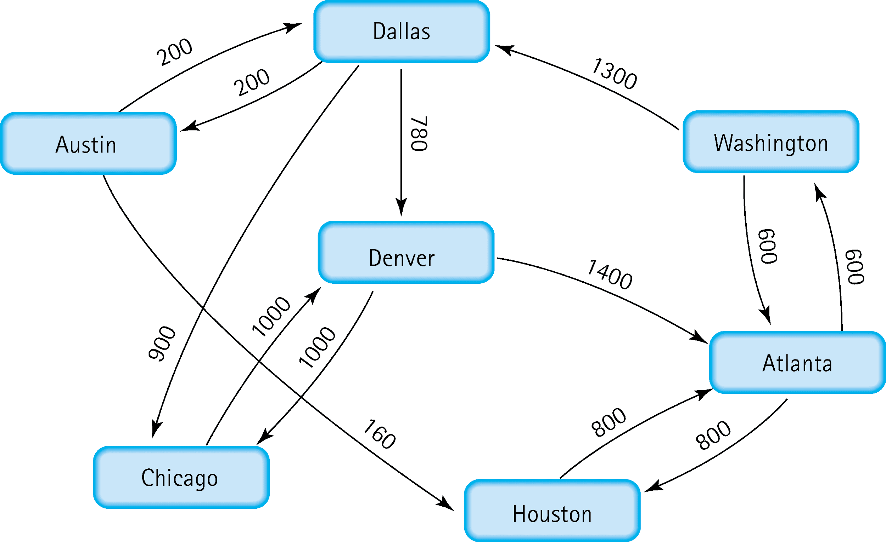
5. Find the shortest distance from Atlanta to every other city
Washington: 600
Houston: 800
Dallas: Washington+1300=1900
Austin: Dallas+200=2100
Houston: Austin+160=2260
Chicago: Dallas+900=1800
Denver=Dallas+780 = 1680

Slide 5
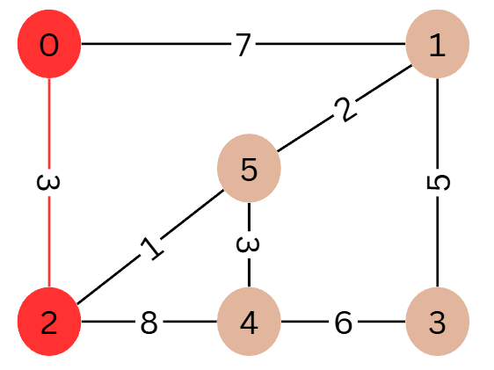
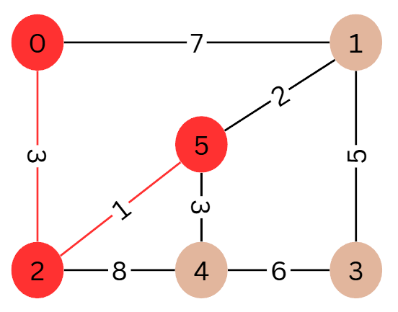
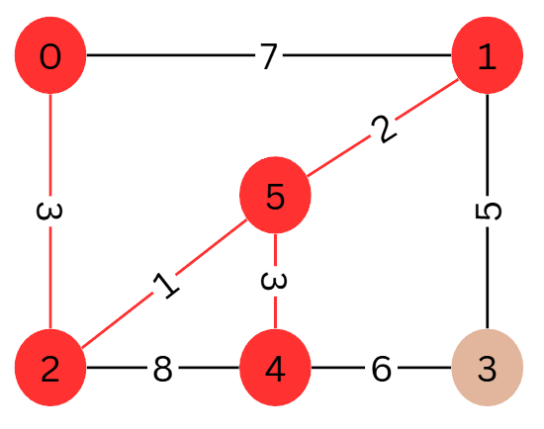
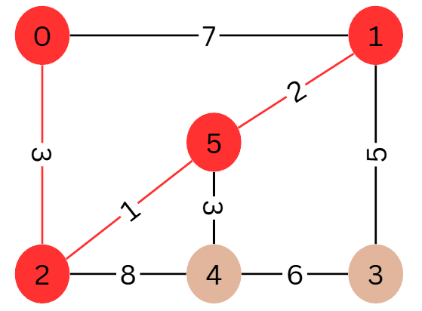
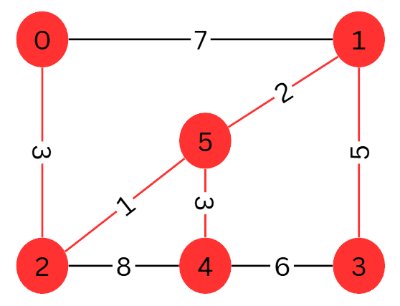
6. Find the minimal spanning tree using Prim’s algorithm. Use
0 as the source vertex . Show the steps.
Step 1: Visited: {0, 2}
Step 2: Visited: {0, 2, 5}
Step 3: Visited: {0, 2, 5, 1}
Step 4: Visited: {0, 2, 5, 1, 4}
Step 5: Visited: {0, 2, 5, 1, 4, 3}

Slide 6
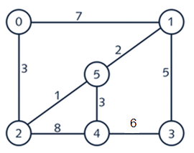
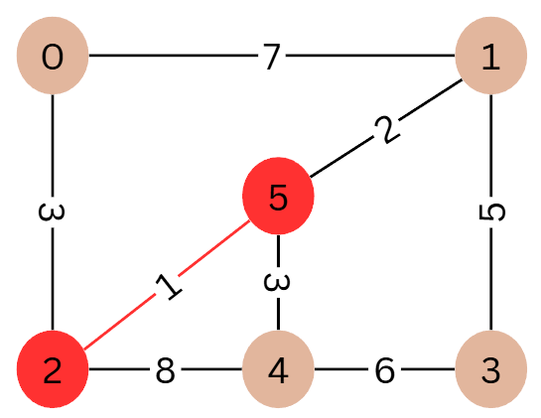
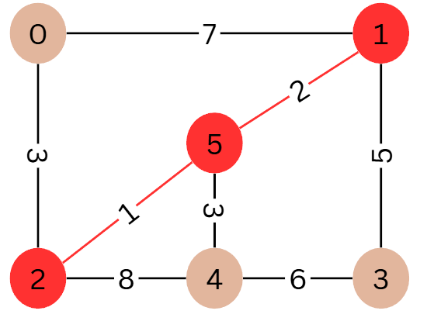
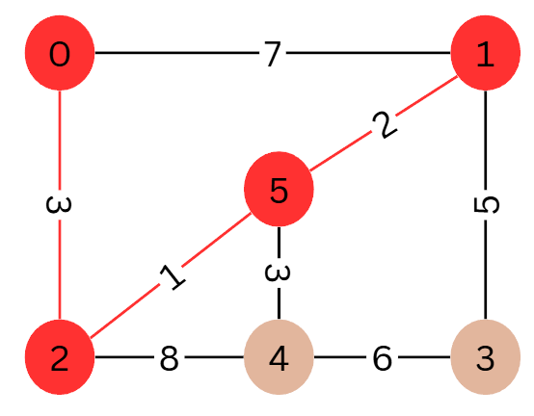
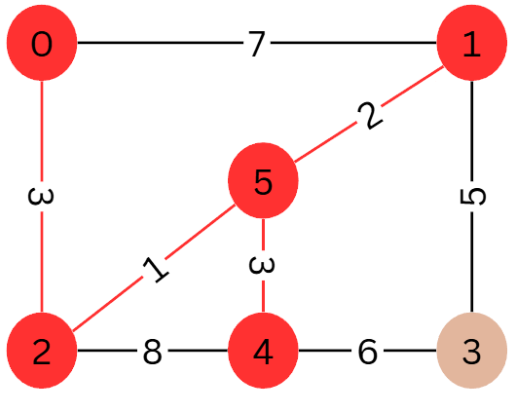
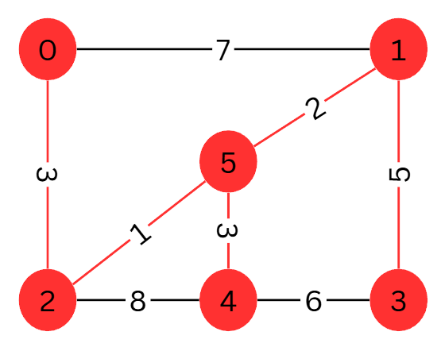
7. Find the minimal spanning tree using Kruskal’s algorithm.
Show the weights in order and the steps.
Step 1
Step 2
Step 3
Step 4
Step 5

Slide 7
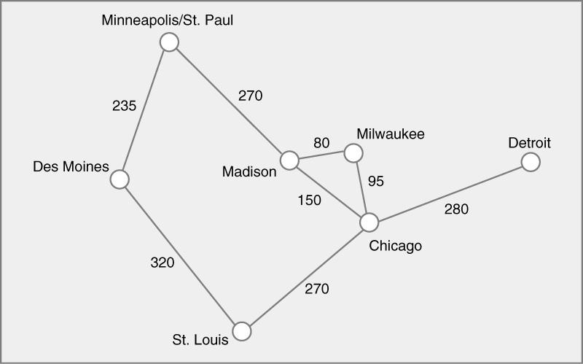
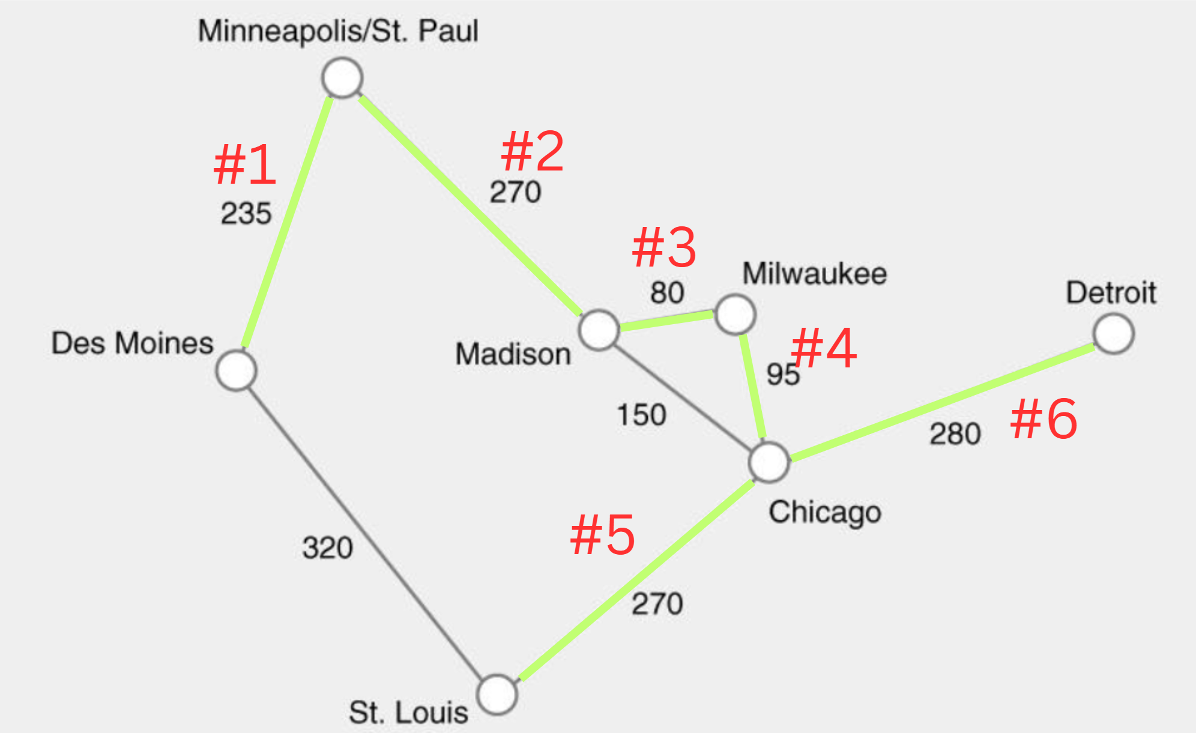
8. Find the minimal spanning tree using the algorithm you prefer. Use
Minneapolis/St. Paul as the source vertex
How many connections? n=nodeCount, minConnections=n-1
7 nodes, 6 min connections.
Prim’s Algorithm

Slide 8
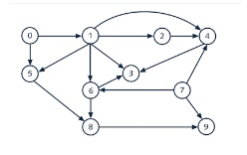
9. List the nodes of the graph in a breadth first topological ordering. Show the
steps using arrays predCount, topologicalOrder and a queue
node | predCount | topologicalOrder | queue
0 | 2 | -- | 5, 1
1 | 5 | 0 | 5, 6, 3, 2, 4
5 | 1 | 0->1 | 6, 3, 2, 4
2 | 1 | 0->1->5 | 6, 3, 4
7 | 3 | 0→1→5→2 | 6, 3, 4, 9
4 | 1 | 0→1→5→2→7 | 6, 3, 9
6 | 1 | 0→1→5→2→7→4 | 3, 8, 9
3 | 0 | 0→1→5→2→7→4→6 | 8, 9
8 | 1 | 0, 1, 5, 2, 7, 4, 6, 3 | 9
9 | 0 | 0, 1, 5, 2, 7, 4, 6, 3, 8 | --
-- | -- | 0, 1, 5, 2, 7, 4, 6, 3, 8, 9 | --

Slide 9

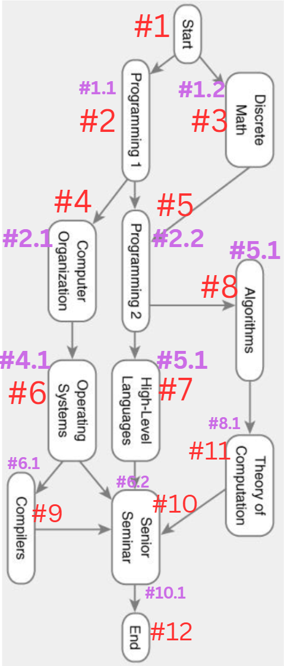
10. List the nodes of the graph in a breadth first topological ordering.
Start
Programming 1
Discrete Math
Computer Organization
Programming 2
Operating Systems
High-Level Languages
Algorithms
Compilers
Senior Seminar
Theory of Computation
End

